Slide 1
Contribution Remittance via Pension Administration Link (PAL) for Employers Using Payroll-based Reporting (PBR)
Updated: May 2025
Notes:
Welcome to this online course about Contribution Remittance using CAAT’s employer portal, Pension Administration Link, or PAL.
PAL makes it easy for you, as a CAAT participating employer, to provide your contribution remittances online.
This course is designed for CAAT employers who use payroll-based reporting or PBR, so if you do not use PBR, please refer to the other Contribution Remittance course for employers using our Data Collection Tool.

Slide 2
Topics
Overview of contribution remittance
Benefits of PAL remittance process
Remittance process walk-through
Revising a remittance
Special situations
Notes:
Here are the topics we’ll cover in this course:
An overview of the contribution remittance process,
A summary of the benefits of using PAL for remittances,
Then a walk-through of the remittance process step-by-step,
Next, a look at revising a remittance in the event of an error, and,
Finally, a look at some special situations you may encounter.
The walk-through will cover an unreported pay period and then a reported pay period.

Slide 3
Contribution remittance overview
Notes:
Let’s start with a few reminders about the contribution remittance process.

Slide 4
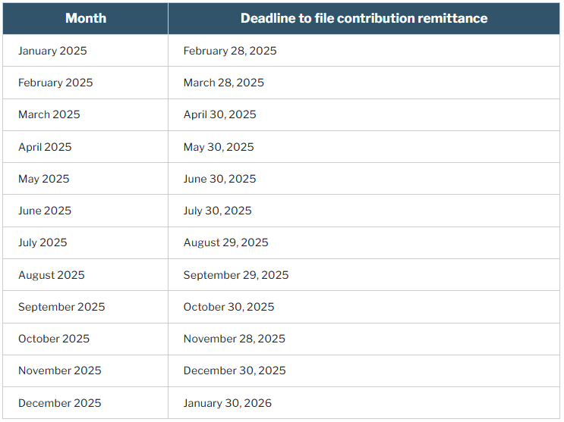
Contribution remittance overview
Key responsibility of all CAAT participating employers
Accurate contribution data facilitates accurate pension calculations for members
Remittance data identifies contribution amounts and the reporting period
Contributions must be received by CIBC Mellon by the 30th calendar day following the end of the month to which the contributions relate
If the 30th of the next month falls on a weekend or holiday, the deadline is the closest previous business day.
Notes:
Collecting member and employer contributions and remitting them on a timely basis is one of the most important responsibilities of all CAAT participating employers. Employers must remit contributions based on their payroll schedule and no less frequently than monthly.
Receiving accurate contribution data and the related funds on schedule allows CAAT to accurately calculate and report accrued pension amounts to CAAT plan members, and ultimately, pay members the lifetime pension they have earned.
A remittance identifies the contribution amounts from the employer and from the members and the period to which the contributions apply.
Contributions are based on eligible earnings and are due to be received by CAAT on or before the 30th calendar day following the end of the month to which the contributions relate. That means, for example, that contributions for the month of February 2024 would normally have been due to be received by March 30th.
However, if the 30th day following the end of the month falls on a statutory holiday or a weekend, the due date for contributions will be the nearest business day before the 30th day.
For example, this happened in March 2024, because the 30th was a Saturday, so that can’t be the due date and the 29th was a statutory holiday, so the due date was the 28th. For easy reference, the Employer Manual contains a list of the deadlines for each month.
Note that contribution remittances received after the due date are subject to a late payment charge.
You can choose to remit contributions before the due date if you wish.

Slide 5
Benefits of using PAL for remittances
Notes:
Let’s look at the benefits of using PAL for remittances.

Slide 6
Benefits of PAL remittance process
Saves time for employers and for CAAT
Allows you to see your remittance history at a glance
Produces a record to accompany your funds so the amount is easily and accurately matched with remittance data
Allows you to combine payments or apply credits
Allows you to edit a pending remittance if needed
Notes:
There are many benefits to using PAL for remittances for both participating employers and for CAAT.
By incorporating the remittance process into PAL, we’ve enhanced the portal experience for you and the goal is saving you time. It saves time for CAAT staff as well.
As you’ll see later in this course, you’ll be able to see your remittance history at a glance in PAL. This may help with your own record-keeping and audit processes.
Also, when you’ve entered your remittance information and submitted it, you’ll receive a downloadable confirmation statement, which you can retain for your records. You can also use this document to accompany a cheque, although CAAT prefers that you use a cheque only if none of the other payment options work for you. For CAAT, the confirmation statement makes the process of matching funds with data faster, with less manual work.
You can include regular payroll contributions and also contributions for pension purchases into one remittance easily, and also apply a credit.
And if you forget something or make an error, you can go back to a pending remittance to edit it.
Let’s take a look.

Slide 7
Remittance process walk-through
Notes:
Here’s a walk-through of the remittance process in PAL.

Slide 8
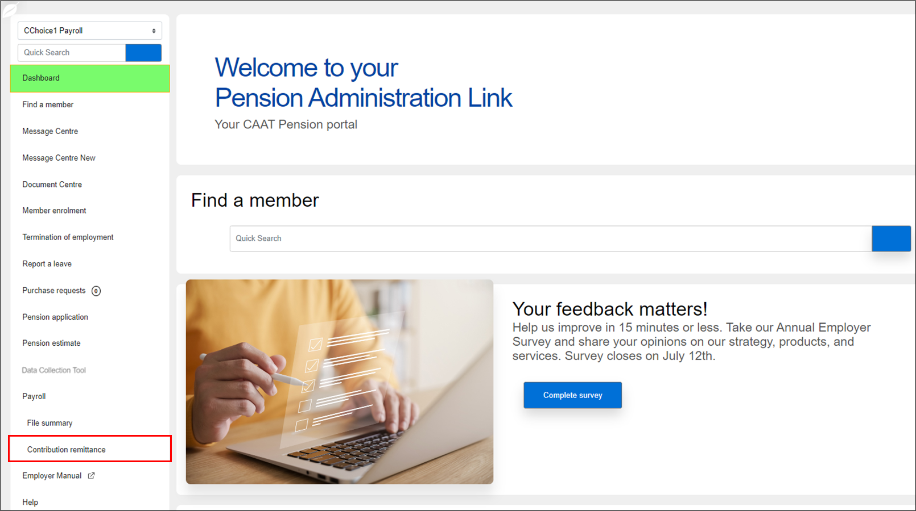
Contribution remittance Log in
Log in to PAL
Select Contribution remittance from the left navigation
Notes:
Getting started is easy.
You’ll first need to log in to PAL. If you don’t yet have PAL login credentials, contact your employer Pension Analyst for assistance.
And you’ll find Contribution remittance in the left menu as the second-last item before Help.

Slide 9
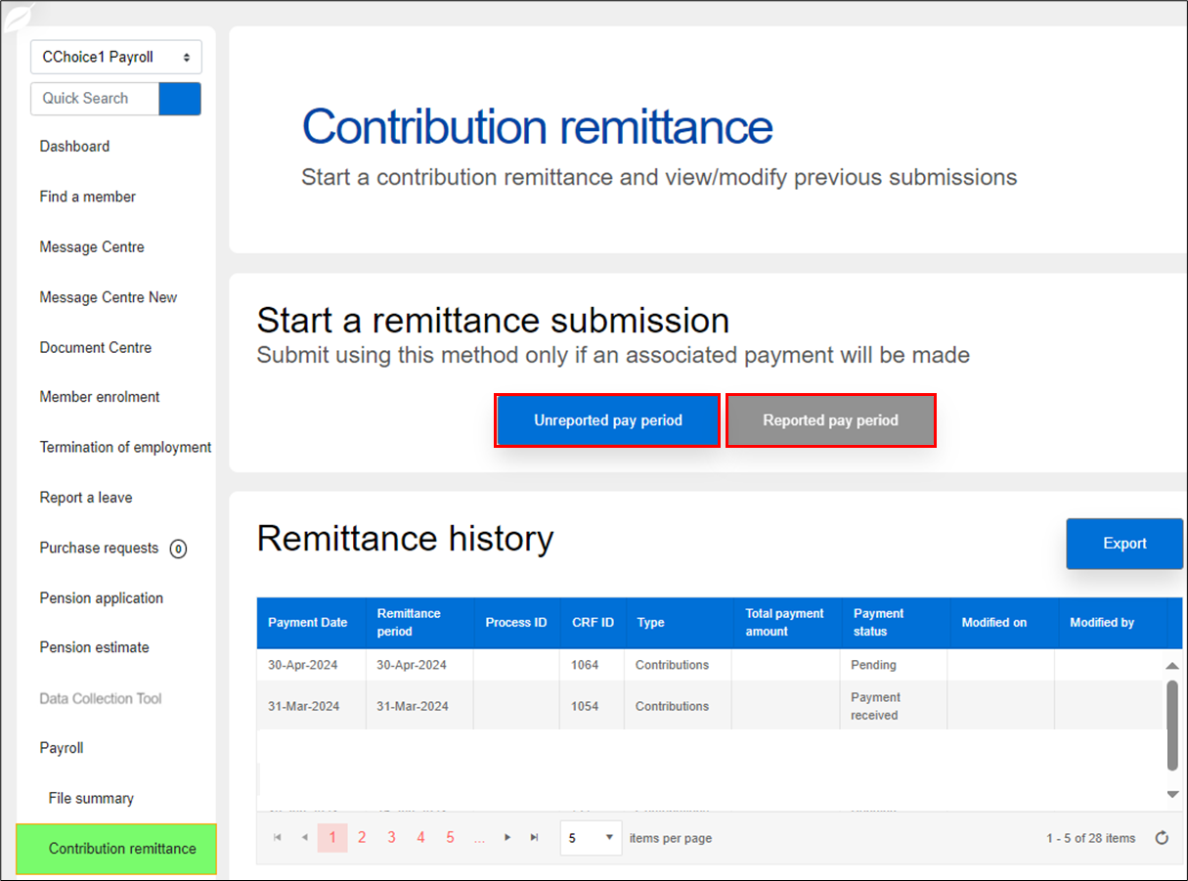
Contribution remittance Start a submission and remittance history
Start a remittance submission:
Unreported pay period, or
Reported pay period
Remittance history shows 2024 pending and completed remittances
Notes:
On the first screen, you can start a remittance submission.
You have two options:
You can choose an unreported pay period — that is, you’re starting from scratch.
Or, you can choose a reported pay period, which means you’ve reported your data through PBR, and you want to remit contributions for that pay period.
Before we move on, notice that you can also view your remittance history on this screen.
We’ll look at that table in more detail when we look at revising a remittance.
Although we expect that most of you will want to use the reported pay period option, let’s look first at starting a remittance for an unreported pay period, because the two processes are very similar.

Slide 10
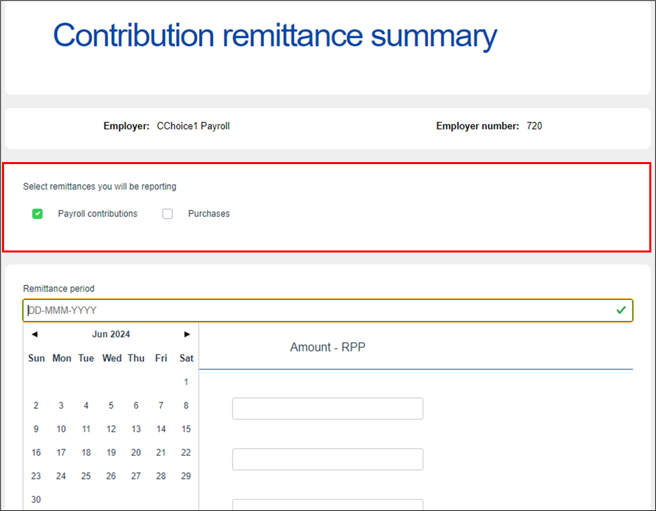
Contribution remittance Steps 1 & 2
Select the type of remittance: Payroll contributions and/or Purchases
Select the end-date of your Remittance period
This date should be the end of the pay period for which contributions are being remitted and not the date you are submitting the remittance information
Notes:
For Step 1, you’ll select the type of remittance — either for Payroll contributions or for Purchases. You can also select both.
For Step 2, you’ll select the end-date of your remittance period. Clicking in the date field will pull up a calendar.
If you’ve provided a payroll schedule to CAAT, usually as part of onboarding, you’ll see dates highlighted in yellow reflecting your pay dates.
If no schedule has been provided, the pay schedule is assumed to be monthly.
The date you select should always be the last day of the period for which the contributions apply and not the date that you are submitting the remittance.

Slide 11
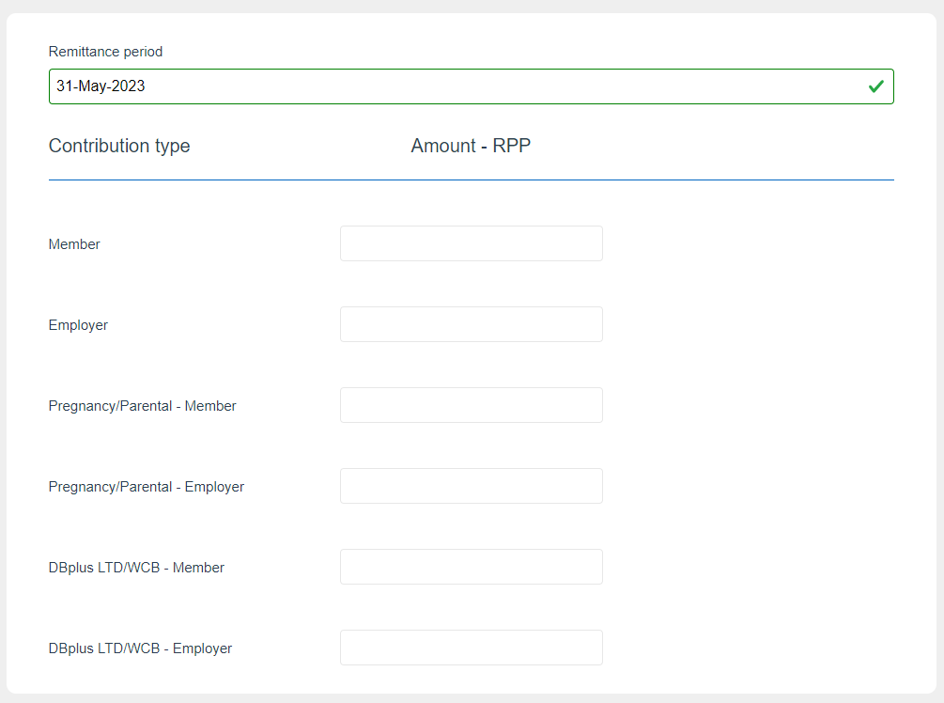
Contribution remittance Step 3
Enter the contribution remittance amount under Amount - RPP — both the Member amount and the Employer amount
Ignore the sections for Pregnancy/Parental leave and for DBplus LTD/WCB
$345.00
$345.00
Notes:
This is a test environment, so let’s say this employer chose May 31st for the end of their pay period.
Your third step is to enter your remittance amounts.
All employers will see the Amount – RPP column.
You’ll enter the pension contribution amount for Members and the amount for the Employer. Usually these match, but not for all employers. For this example, let’s use $345 for each.
You can ignore the next two sections , because the general approach for PBR is to include amounts for Pregnancy/Parental Leave and Long-term disability or workers’ compensation leave along with your regular payroll contributions.

Slide 12
Contribution remittance Optional Steps 4 to 7
If you wish, you can:
Pay any outstanding invoices
Pay any balance due from your annual reconciliation
Include an amount if you have member contributions not previously reported (e.g., a missed contribution)
Apply a credit amount, if any
Notes:
Steps 4 to 7 are optional. They’ve been included to streamline the remittance process. So, these are set to “No” and you only click “Yes” if you need to use them.
You have the option to:
Pay any outstanding invoices, such as a late payment charge, if applicable,
Pay any balance due to CAAT from your annual reconciliation,
Include an amount in respect of member contributions not previously reported — in other words, a missed contribution, OR
Apply a credit amount from your annual reconciliation.
Before this enhancement to PAL, you might have made a number of remittances to account for all these situations — now you can complete them all in one remittance with just a few clicks.
We’ll assume “No” for all these options, then come back to them later when we show another example.

Slide 13
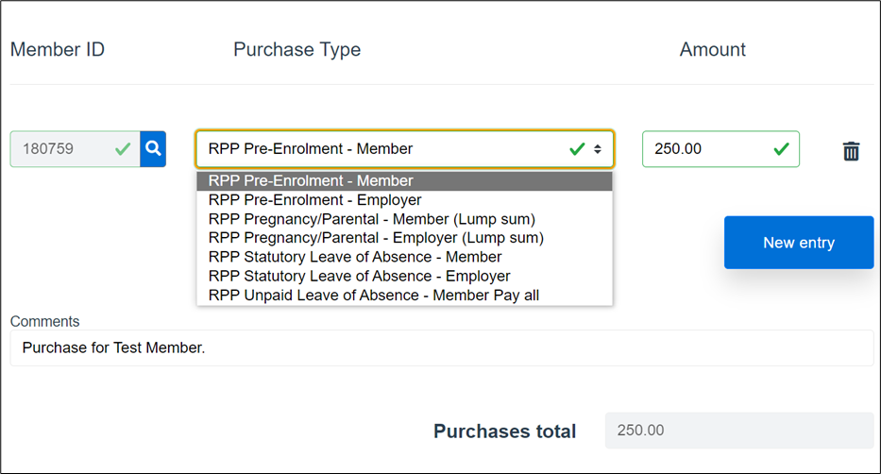
Contribution remittance Step 8
If you are also submitting contributions for a pension purchase:
Search for the Member ID
Select the Purchase Type
Include the Amount
Add Comments if you wish
Notes:
If you are submitting contributions for a pension purchase, you’ll see this section appear following the previous four optional sections.
It’s easy to complete:
Search for the Member ID by clicking the magnifying glass icon.
Then, select the Purchase Type from the drop-down. In this example, the member is making a purchase in respect of service before they enrolled in the Plan.
Then include the Amount.
You can add Comments if you wish.
To add a purchase for another member, simply click the New entry button.
Note that you have the option combine a remittance for a purchase with your regular contribution remittance, or you also can submit a remittance for a purchase all by itself. It’s up to you.

Slide 14
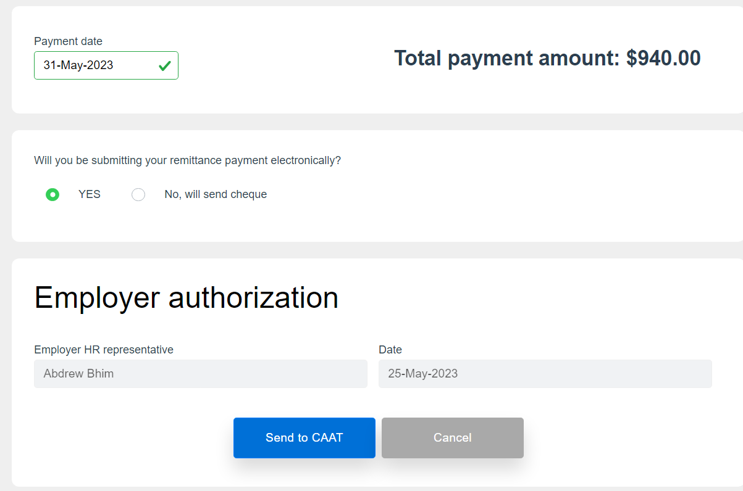
Contribution remittance Steps 9 to 12
Confirm the Payment date
Select your payment method
Electronic submission (EFT)
Cheque
Complete the Employer authorization
Select Send to CAAT
John Smith
Notes:
Here are the next steps to finalize your remittance.
Once you’ve entered your remittance amounts, you’ll see a Total payment amount, which will include both regular contributions and the amount for any purchases you have entered. (In this example, 2 x $345 plus $250 = $940.)
Then, you need to confirm the Payment date. This should be the date the payment is actually provided, not the due date.
And select your payment method, which defaults to electronic submission, but you can select a cheque if you prefer.
The Employer authorization is automatically populated based on your user information.
Then you choose Send to CAAT.
If you realize you made an error, you can choose Cancel, but everything you’ve entered will be deleted and you’ll have to start again.

Slide 15
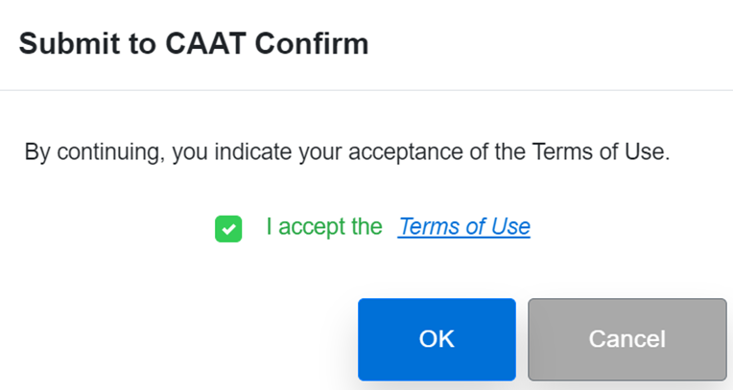
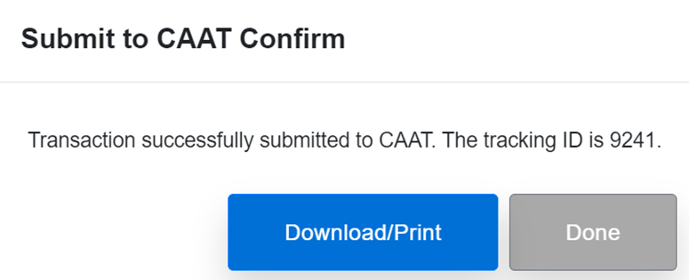
Contribution remittance Confirmation
Accept the Terms of Use
Click OK
Download/print if you wish, click Done
Notes:
Next, you’ll have to accept the Terms of Use and click OK.
Your submission will be assigned a tracking ID, which will show in the remittance history table.
You can download or print a confirmation for your records (or print to PDF), then click Done to exit.

Slide 16
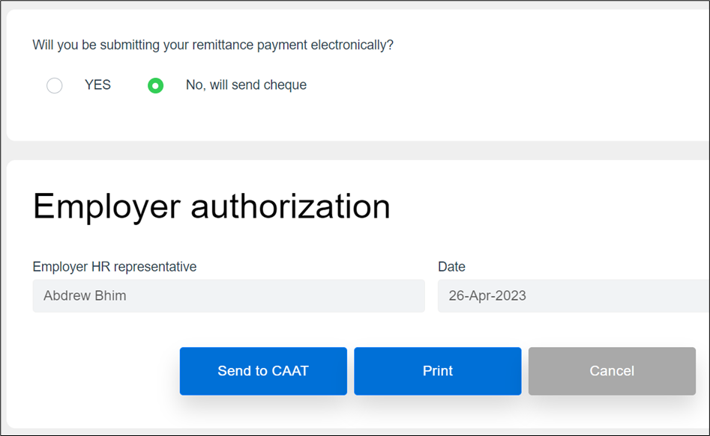
Contribution remittance Payment by cheque
If you select payment by cheque, be sure to print a copy of your remittance information, so you can include it along with your cheque
John Smith
Notes:
If you select payment by cheque, be sure to print a copy of your remittance information, so you can include it along with your cheque.

Slide 17
Reported pay period
Notes:
Next, we’ll look at how to start a remittance submission for a pay period that you’ve already reported through PBR.
This is what we expect most employers who use PBR will want to do, and only the first few steps are different.

Slide 18
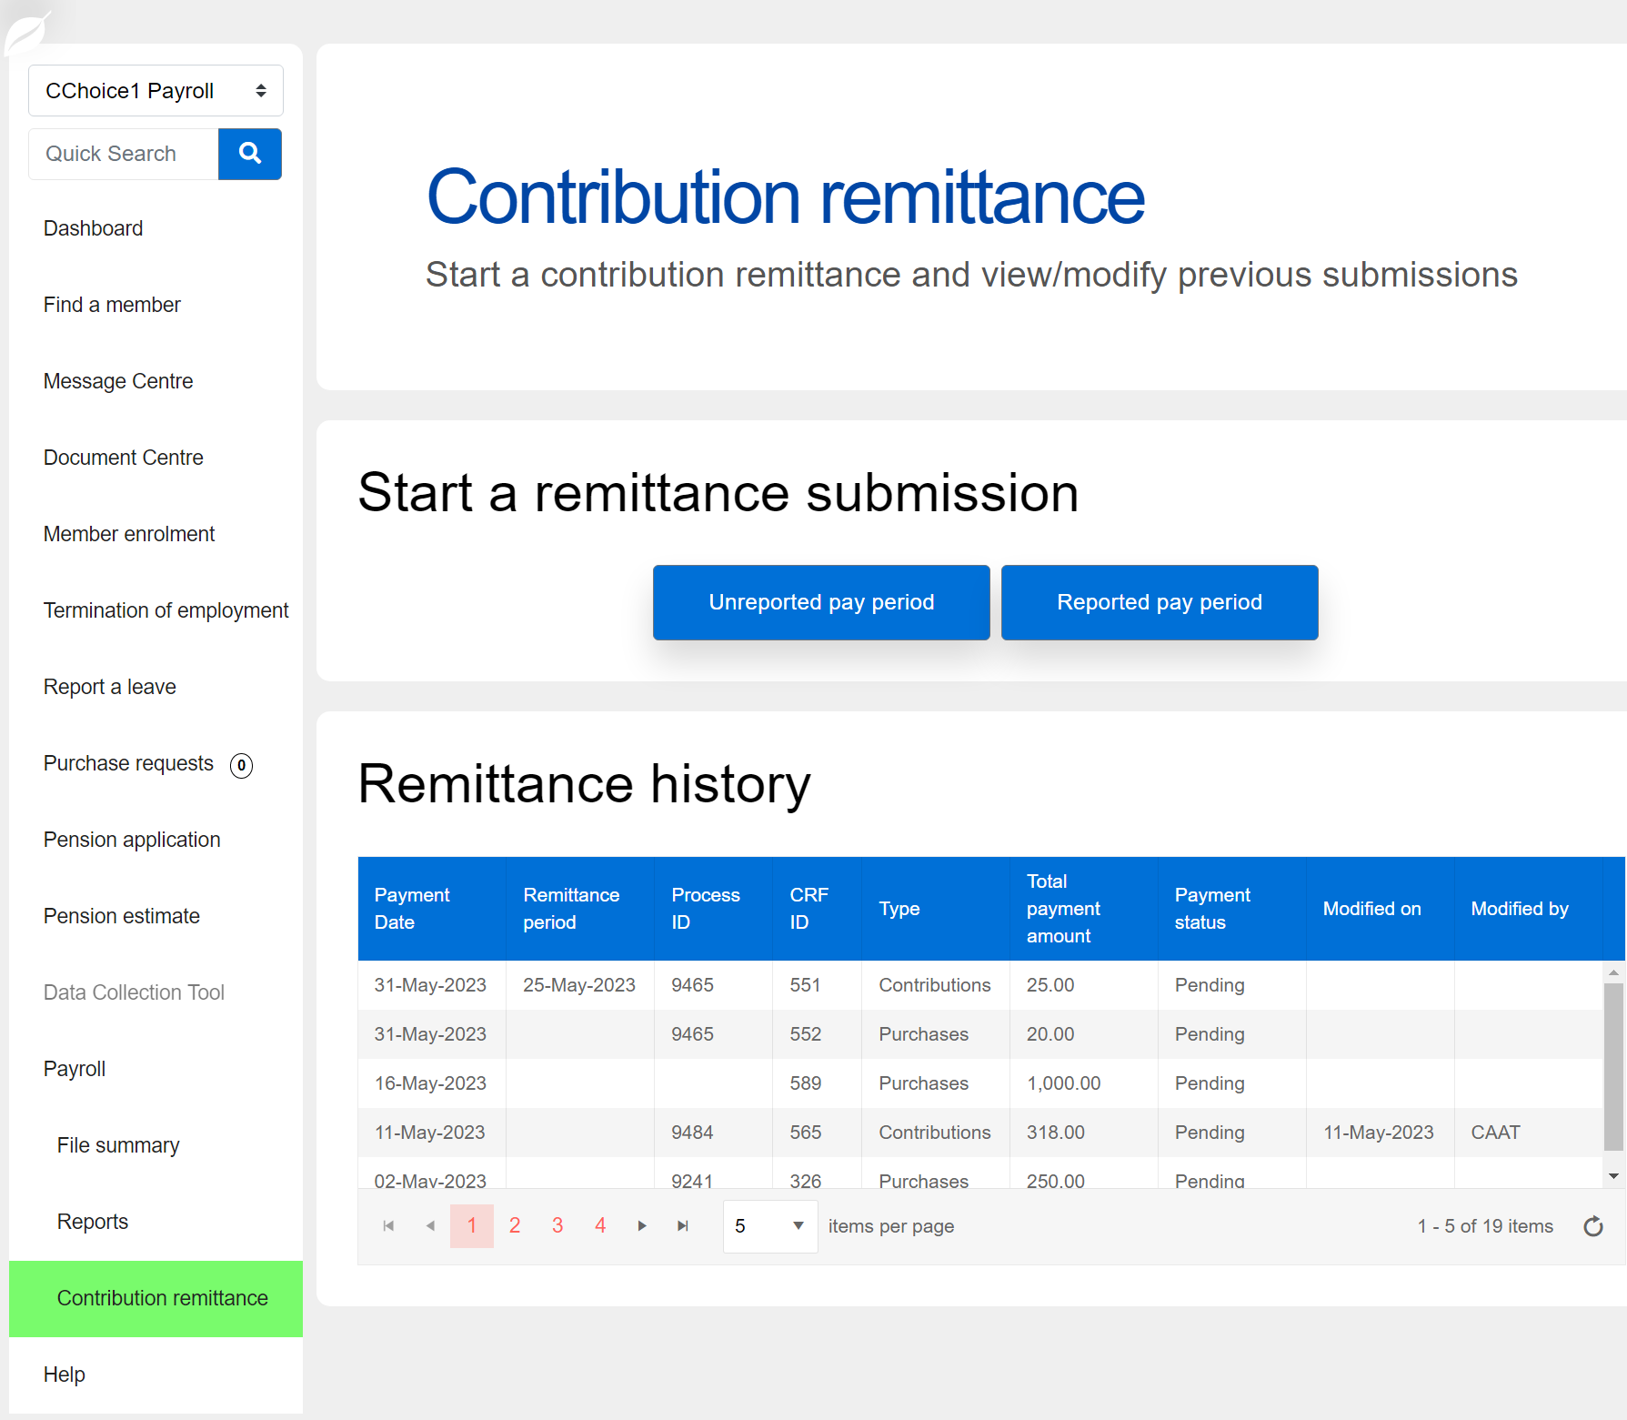
Contribution remittance Submission for a reported pay period
Start a remittance submission if you have already posted your payroll file:
Select Reported pay period
Button is enabled only if you have submitted and 100% posted your payroll file for the remittance period
Notes:
On the first screen, you would choose Reported pay period.
If you see the button, but it is greyed out, it may be because your PBR file is not 100% posted.
The button is enabled only if you have submitted and 100% posted your payroll file for the remittance period.

Slide 19
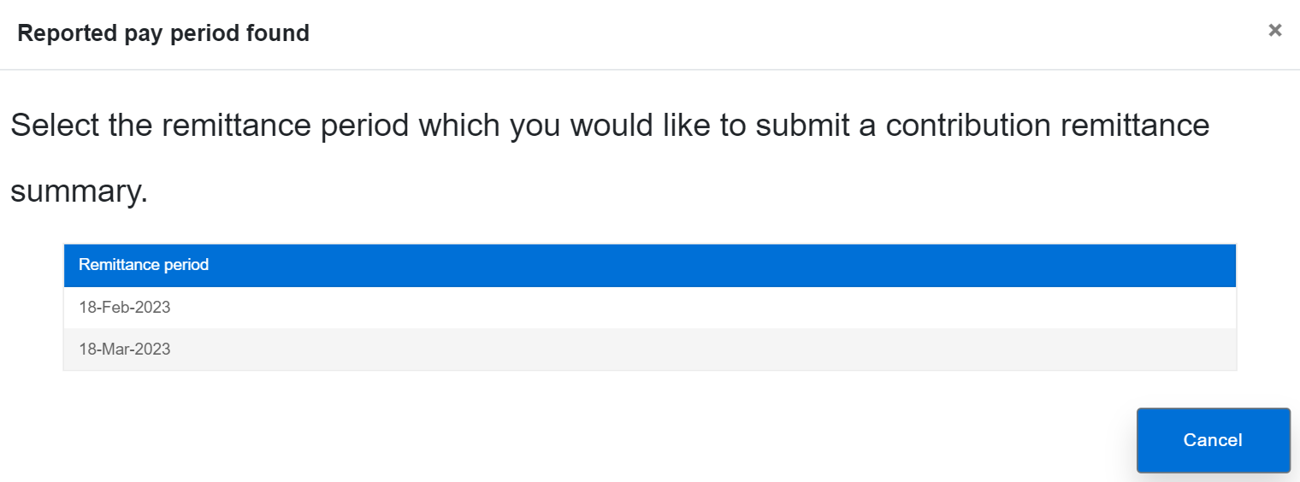
Contribution remittance Select the remittance period
Select the applicable remittance period to start your contribution remittance
Notes:
Next, select the applicable remittance period to start your contribution remittance.

Slide 20
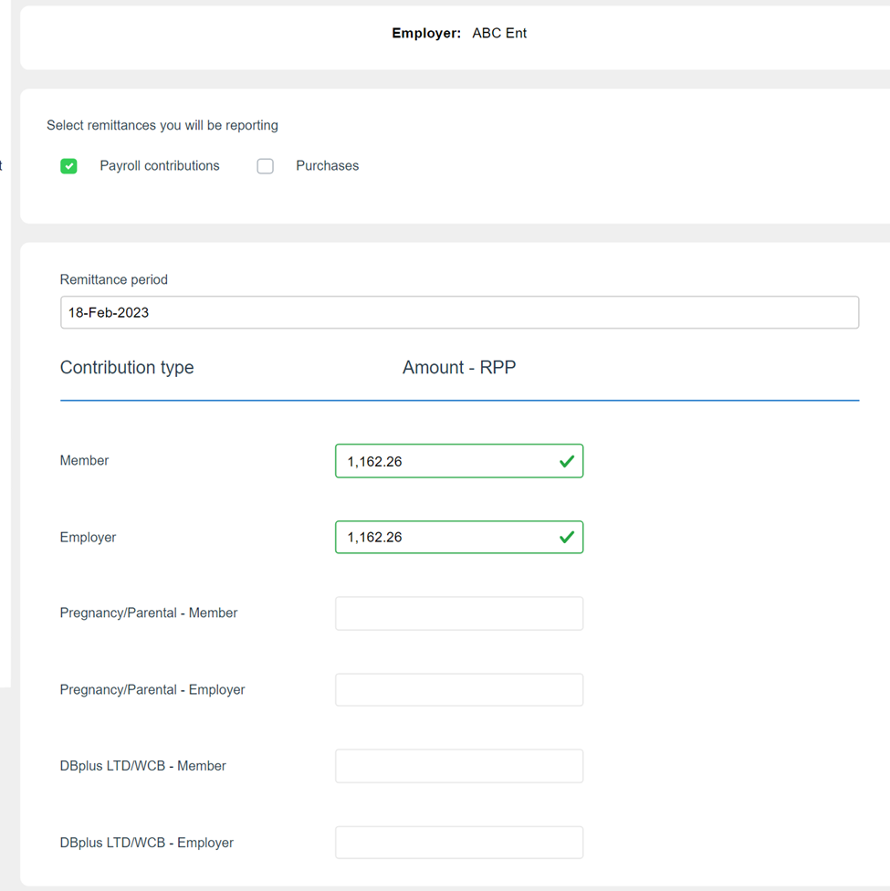
Contribution remittance Data is pre-populated
Contribution amounts are pre-populated based on your PBR record for that period
You can add purchases, if applicable
Notes:
The main difference with using the Reported pay period option versus the Unreported pay period, is that the data is pre-populated from your submitted payroll file, so you don’t have to enter the amounts again. Take a moment, though, to confirm the amounts are correct before proceeding.
You have the option here to click the Purchases button if you want to add a contribution for a pension purchase.
From here on, the process is the same as I showed you earlier.

Slide 21
Payroll file summary pathway
Notes:
You can also access a pre-populated remittance through the Payroll file summary page.

Slide 22
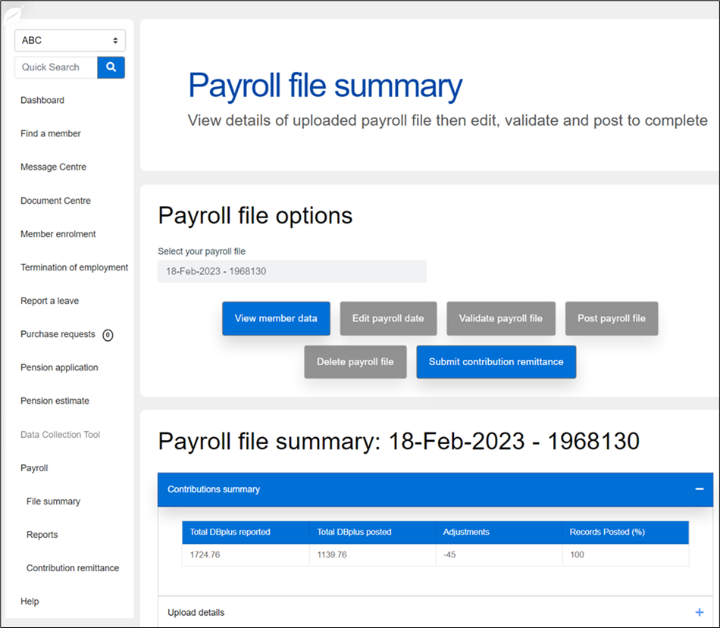
Contribution remittance Submission for a reported pay period
To start a remittance submission if you have posted your payroll file:
Select File summary
Submit contribution remittance button is enabled only if you have submitted and 100% posted your payroll file for the remittance period
Notes:
This is another route within PAL, which is probably the fastest. You can select File summary from the left menu.
If there is a remittance expected for the payroll date, then the Submit contribution remittance button will be active.
Again, all payroll records must be 100% posted, or this button will not be active, it will be greyed out.
The flow of steps and the outcome is exactly the same as using the Reported pay period button — this is just another entry point that might be more convenient for you.

Slide 23
Revising a remittance
Notes:
Next, we’ll look at how to revise a remittance you’ve already submitted.

Slide 24
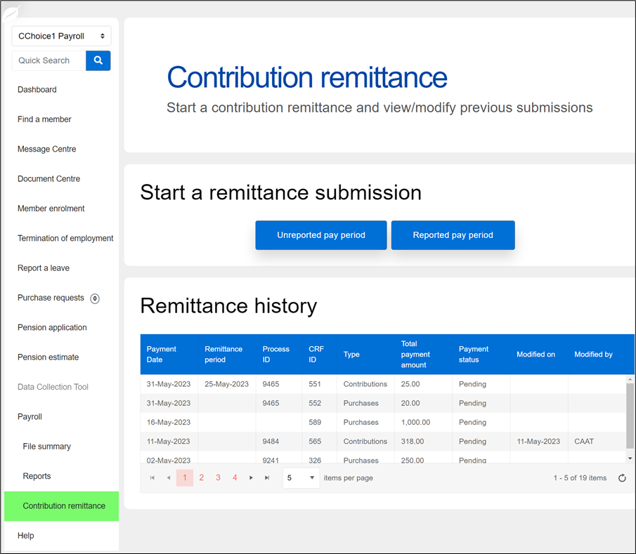
Contribution remittance Accessing submitted records
Return to the Remittance history table
Select any record to view it
Submissions that combined payroll contributions and purchases will be shown as two separate records
Select any Pending record to
Revise it, or
Delete it
Notes:
If you’d like to go back to revisit a submission, you can return to the Remittance history table by selecting Contribution remittance in the menu.
Let’s look at this history table a bit more closely. This example is from 2023, but your view should show any 2024 and 2025 remittances to date that were submitted through PAL.
The table will show nine columns, starting with the Payment date.
Then it shows the Remittance period — which should be the last day of the pay period to which the remitted contributions apply.
Next, CAAT assigns a Process ID, followed by the contribution remittance form ID, or CRF ID — that’s a number assigned to your remittance when you submit it.
That’s followed by the contribution Type — whether for Contributions or Purchases.
Then, the Total payment amount and Payment status.
Pending means the remittance can still be edited.
It will also show the date that the record was last modified and whether it was modified by you or by CAAT.
You can view a record of any previous submission — either for payroll contributions or a purchase — by selecting the record in the table.
As we saw earlier, both payroll contributions and contributions for a pension purchase can be done through one remittance. However, when you’re going back to revise a remittance, the records will appear separated in the table, so that the payroll and purchase remittances both have the same Process ID, but two different CRF IDs.
As we continue to enhance and improve PAL, we’ll introduce the ability to view both payroll contributions and purchases that were submitted together. We’ll notify you when this new functionality is available.
If you want to revise or delete a record, you can only change one that is marked Pending.
If the record says, “Payment Allocated,” it can’t be revised. Please contact your employer Pension Analyst to assist you in that situation.
Let’s see next how a pending record can be revised.

Slide 25
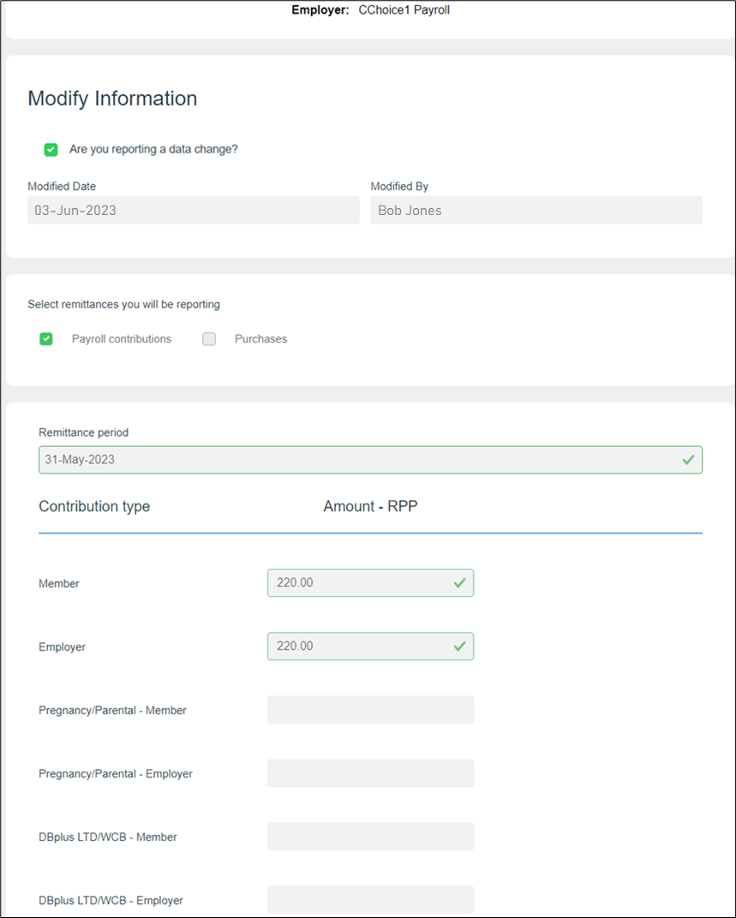
Contribution remittance Revising a record
Click the check box “Are you reporting a data change?” in order to edit the form
Indicate the Modified Date
Include your name in Modified By
The form will show the fields with checkmarks; click in a field to edit it
Notes:
To start your revision, click the check box, “Are you reporting a data change?” in order to edit the form.
The Modifed Date and the Modified By field will be auto-populated with the current date and your user name.
You’ll see that all fields have checkmarks because this is an existing pending submission.
Click in any field to edit it.
So, here, we’ve updated the member and employer amounts to $220, but you could also add amounts for Pregnancy/Parental contributions, or for DBplus LTD/WCB.
Let’s assume we’re leaving those amounts as is, but we have other changes to make, so we’ll look at some special situations.

Slide 26
Special situations
Notes:
Here are some additional options we’ve added to the PAL contribution remittance process to streamline it.
You can cover off these special situations either in an initial remittance or as a revision to a pending remittance.

Slide 27
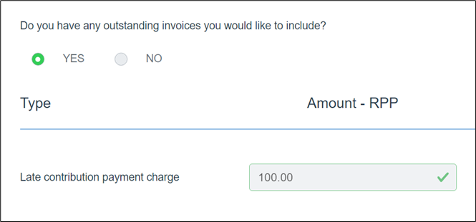
Contribution remittance Outstanding invoices
You can pay any outstanding invoices, e.g.,
Late contribution payment charge
Include the amount in the field
Notes:
For example, if you click “Yes” for “Do you have any outstanding invoices you would like to include?”
You can pay a late contribution payment charge.
Simply include the amount in the field.

Slide 28
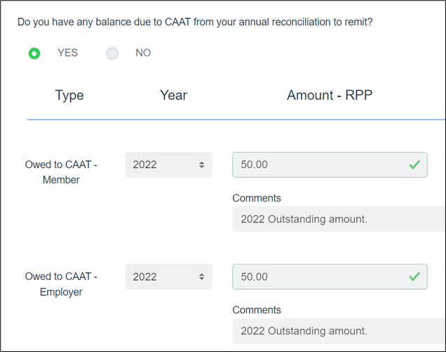
Contribution remittance Balance due
If there is a balance due to CAAT from your annual reconciliation, it can be included
Select the year
Include the amount
Add comments (optional)
Notes:
If you click “Yes” to the question “Do you have any balance due to CAAT from your annual reconciliation to remit?” the field will expand.
You can select the year from the drop-down and include the amount — for both Member and Employer contributions.
And you can add a comment if you wish.
We’re skipping the next option, which asks “Do you have any member contributions not previously reported to include?” because it’s not applicable to you.

Slide 29
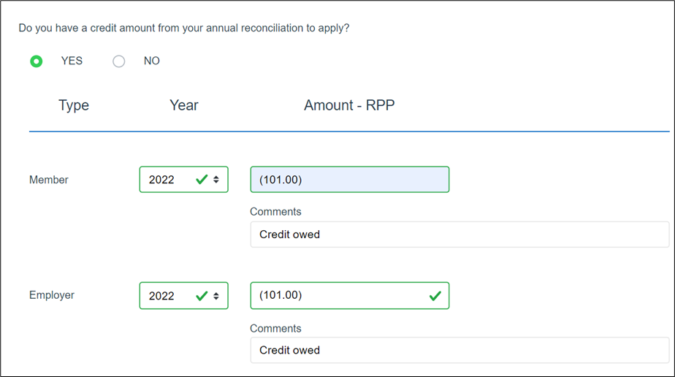
Contribution remittance Credit amount
You can apply a credit amount from your annual reconciliation, if applicable
Select the year
Enter the amount(s) for Member and Employer, as applicable
Add comments (optional)
Notes:
The last option you have is to add a credit amount from your annual reconciliation.
Applying a credit will reduce the amount of your required monthly contribution remittance by the same amount.
Choose the applicable year from the drop-down for both the Member and Employer amounts.
Enter the amount for each, as applicable.
The system knows this is a credit, so will automatically show it as a negative amount — shown here by the parentheses.
And add a comment if you wish.

Slide 30
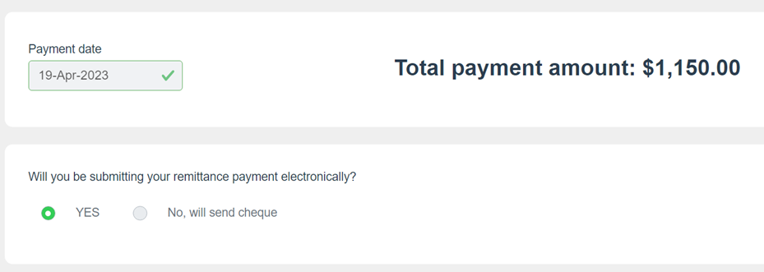
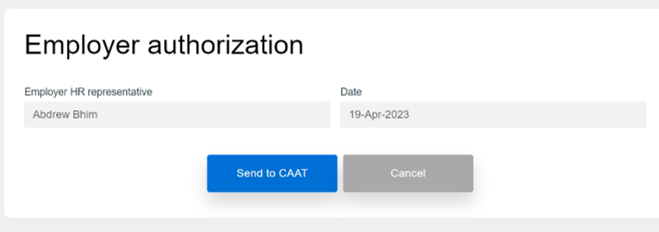
Contribution remittance Update your payment and submit it
Confirm the Payment date
Select your payment method
Electronic submission (EFT)
Cheque
Complete the Employer authorization
Select Send to CAAT
03-Jun-2023
Bob Jones
03-Jun-2023
John Smith
Notes:
If you update a record that was Pending, and this means your remittance amount is now higher, you can remit the additional amount required as part of your revision.
If the revision means your original remitted payment is more than required, then CAAT will issue you a credit for the difference.
If you’re making an additional payment, you’ll need to go through Steps 9 to 12 again, to choose your payment date and method. Then the Employer authorization will be populated automatically, and you’ll select Send to CAAT.
You’ll need to accept the Terms of Use and click OK.
If you’re paying by cheque, print or download a copy of your remittance to accompany the cheque.
And that is how simple and easy it is.

Slide 31
Notes:
This concludes our presentation for today.
The slides from today’s session are available for download in the handouts section of the control panel. We will also be making a recording of this session available on our website. If you have any questions, please reach out to your employer Pension Analyst.
Thanks again for attending and have a great day!

